Slide 1
DI4D Project
Maurits, David, Govart

Slide 2





Goal of application

Slide 3


Type of users
Public User
Sharepoint User
Partner
Student

Slide 4
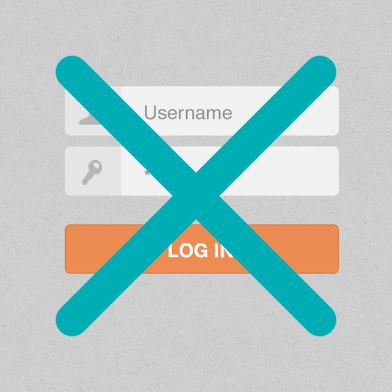
Type of users
Public User

Slide 5
Type of users
Sharepoint User

Slide 6



Type of users
Sharepoint User
Partner

Slide 7


Type of users
Sharepoint User
Student

Slide 8
Prototype

Slide 9
Thank you for your attention. Questions?

